Slide 1
Link-State Protocols, IP Addressing
Lecture X
CS 168, Fall 2024 @ UC Berkeley
Slides credit: Sylvia Ratnasamy, Rob Shakir, Peyrin Kao, Iuniana Oprescu
Notes:
Slides template credit: Josh Hug, Lisa Yan

Slide 2
Link-State Protocols
Link-State Protocols
Overview
Computing Paths
Learning Graph Topology
IP Addressing
Hierarchical Addressing
Assigning Addresses
Writing Addresses
Aggregating Routes
IPv6 Changes
Lecture X, CS 168, Fall 2024

Slide 3
Routing Protocols – Roadmap
Routing protocols can be classified by:
Where they operate. (Intra-domain or inter-domain.)
How they operate. (Distance-vector, link-state, or path-vector.)
Today, we'll look at link-state protocols.
Very common as an Interior Gateway Protocol.
Major examples:
IS-IS (Intermediate System to Intermediate System).
OSPF (Open Shortest Path First).
 | Intra-domain (Interior Gateway Protocol) | Inter-domain (Exterior Gateway Protocol)
Distance-vector | RIP | –
Link-state | IS-IS, OSPF | –
Path-vector | – | BGP

Slide 4
Link-State Protocols: Definition
Link-state protocols:
Every router learns the full network graph.
Then, each router runs a shortest-path algorithm on the graph to populate the forwarding table.
How do routers learn this?
What algorithm do we run?
Distance-vector:
Local data: Each node only knows about part of the network.
Global (distributed) computation: Each node computes part of the solution, working with other nodes.
Link-state:
Global data: Each node knows about the full network graph.
Local computation: Each node computes the full solution by itself.

Slide 5
Global Data
Suppose R3 has learned the full network graph.
We know all the links, their status (up or down?), and their costs.
We know about all the destinations.
R3 can run a graph algorithm to compute paths.
We can populate the forwarding table with the next-hop (in the computed path).
How do routers learn this?
What algorithm do we run?
1
R1
R2
10
R3's Table
Destination | Next Hop
A | R2
... | ...
1
R3
2
R4
1
A
1
7
R5
B
1

Slide 6
Computing Paths
Link-State Protocols
Overview
Computing Paths
Learning Graph Topology
IP Addressing
Hierarchical Addressing
Assigning Addresses
Writing Addresses
Aggregating Routes
IPv6 Changes
Lecture X, CS 168, Fall 2024

Slide 7
Link-State Algorithms
What graph algorithm do we run to compute paths?
Any single source shortest-path algorithm will work.
Need to find shortest paths from a single source (the router) to every host.
Some possible choices:
Bellman-Ford (the original serial version).
Dijkstra's algorithm.
Breadth-first search.
Dynamic shortest path.
Approximate shortest path.
Parallel single-source shortest path.

Slide 8
Ensuring Consistency
Each router can only influence its next hop.
No guarantee that routers compute the same paths!
We have to ensure that every router is using a "compatible" approach.
R1
R1
R2
R2
R3
R4
A
R3
R4
A
R5
B
R5
B
R3 forwards to R2.
R2 forwards to R3.

Slide 9
Ensuring Consistency
Requirements for routers to produce valid, compatible decisions:
Everyone agrees on the network topology.
Everyone is minimizing the same cost metric.
All costs are positive.
All routers use the same tie-breaking rules.
Routers don't necessarily need to use the same shortest-path algorithm, as long as they follow these rules.
In practice, easier to have everyone use the same algorithm.

Slide 10
Learning Graph Topology
Link-State Protocols
Overview
Computing Paths
Learning Graph Topology
IP Addressing
Hierarchical Addressing
Assigning Addresses
Writing Addresses
Aggregating Routes
IPv6 Changes
Lecture X, CS 168, Fall 2024

Slide 11
Steps of Learning Network Graph
Link-state protocols:
Every router learns the full network graph.
Step 1A: Discover my neighbors.
Step 1B: Tell everybody about my neighbors.
Then, each router runs a shortest-path algorithm on the graph to populate the forwarding table.
How do routers learn this?

Slide 12
Steps of Learning Network Graph (1/2) – Learn Neighbors
How do we discover who is adjacent to us and their identity? Say hello!
Routers periodically send hello messages to their neighbors.
If they stop saying hello, assume that they disappeared.
This helps us learn about our direct neighbors, but not the whole network.
R1 does not know about the rest of the network (e.g. R3).
My neighbors are R1 and R3.
Hello, I'm R1.
Hello, I'm R3.
R1
R2
R3
My neighbor is R2.
My neighbor is R2.
Hello, I'm R2.
Hello, I'm R2.

Slide 13
Steps of Learning Network Graph (2/2) – Propagate Neighbor Information
How do we learn about the rest of the network, beyond our neighbors?
Solution: Flood information across the network.
When local information changes, send it to everyone.
When you receive information from your neighbor, send it to everyone.
R1 and R2 are neighbors. Tell everyone!
R1 and R2 are neighbors. Tell everyone!
R1 and R2 are neighbors. Tell everyone!
R1
R2
R3

Slide 14
Avoiding Infinite Flooding
Flooding: When you receive an update, send it to everybody.
We have to be careful of the same update being sent repeatedly.
R1
R2
R5 and R9 are neighbors.
R5 and R9 are neighbors.
R5 and R9 are neighbors.
R5 and R9 are neighbors.
R5 and R9 are neighbors.

Slide 15
Avoiding Infinite Flooding
Amplification: When there's a loop, copies of the same message get multiplied.
R1
R2
R3
Notes:
Does this animation make any sense or am I just hallucinating?

Slide 16
Avoiding Infinite Flooding
Amplification: When there's a loop, copies of the same message get multiplied.
This edge means, R1 sends the message to R2.
R1
Then, R2 sends it to R1, and so on.
R2
R3
R1
R3
R1
R2
R2
R3
R1
R2
R2
R3
R1
R3
R1
R3
R1
R2
R2
R3
R1
R3
R1
R3
R1
R2
R2
R3
R2
R3

Slide 17
Avoiding Infinite Flooding
Problem: Naive solution (send to all neighbors) causes amplification.
Solution:
When local information (about yourself) changes, send it to all neighbors.
When you receive a packet from a neighbor, send it to all neighbors...
...unless you've already seen the packet before.
To identify packets you've seen before, add a timestamp.
Or some other unique identifier, e.g. strictly increasing sequence numbers.
✓ Seen it.
R1
✓ Seen it.
R2
R3
✓ Seen it.

Slide 18
Ensuring Reliability
The network is still best-effort. Updates could get dropped.
Recall: We need all routers to agree on topology, or else paths might be invalid.
Solution: Periodically re-send the update.

Slide 19
Ensuring Convergence
The network could change. What happens if a link goes down?
Wait for routers to detect the failure.
Wait to flood new information.
Wait to recompute paths.
While waiting for convergence, the routing state might be invalid.
Dead ends and loops. Packets using longer routes.
A
A
R2
R3
R2
R3
R1
R1
Link is down, but R1 doesn't know!
R1 forwards to R3.
R3 knows about the link failure!
R3 forwards to R1.

Slide 20
Link-State vs. Distance-Vector
Link-state is relatively simple. All the complexity is in the details!
Everyone floods link/destination information.
Everyone has a global map of the network.
Everyone independently computes next-hops.
Why might we want to use link-state over distance-vector?
Link-state gives routers more control over the path they choose.
Distance-vector: We have to trust what our neighbor says, and we don't know the path they're using.
Link-state might be better at converging.
Distance-vector: Wait for neighbor to recompute and re-advertise path.
Link-state: Flood information before recomputing.
Real networks often use a combination of path/distance-vector and link-state.

Slide 21
Hierarchical Addressing
Link-State Protocols
Overview
Computing Paths
Learning Graph Topology
IP Addressing
Hierarchical Addressing
Assigning Addresses
Writing Addresses
Aggregating Routes
IPv6 Changes
Lecture X, CS 168, Fall 2024

Slide 22
Scaling Routing
Can we really scale routing and forwarding to every host on the Internet?
Distance-vector: How many routing calculations does each router do?
Link-state: Can we really store the entire network graph in every router?
How long does it take to re-converge?
The secret to scaling routing is how we do addressing.
The trick: Use more informative names than A, B, C, D for destinations.
R3's Table
Destination | Port
A | 0
B | 1
C | 1
D | 2
... | ...
One entry for every possible destination.
Disclaimer: Today is about IP (Layer 3) addresses. Other layers use different addressing systems.

Slide 23
Hierarchical Addressing – Conceptual
Recall: The Internet is a network of networks.
Leads naturally to a hierarchy of addresses.
Each network gets a number. Then, each host gets a number inside the network.
Network 1
Network 2
2.1
2.2
2.3
Network 3
1.2
1.1
2.4
3.1
3.2
2.5
Network 4
3.3
2.6
2.7
4.1
4.2
4.3
4.4
4.5
4.6

Slide 24
Hierarchical Addressing – Conceptual
R9 can summarize all hosts in another network with a single table entry.
Huge scaling improvement! Tables are smaller now.
R9's Table
Destination | Next Hop
1.* | R6
3.* | R6
4.* | R8
... | ...
Network 1
Network 2
2.1
2.2
2.3
Network 3
R6
1.2
1.1
2.4
R9
3.1
3.2
2.5
Network 4
R8
3.3
2.6
2.7
4.1
4.2
4.3
4.4
4.5
4.6

Slide 25
Hierarchical Addressing – Conceptual
Hierarchical addressing limits table churn.
Changes inside a network don't affect tables in other networks.
R9's Table
Destination | Next Hop
1.* | R6
3.* | R6
4.* | R8
... | ...
No change in table entry!
Network 1
Network 2
2.1
2.2
2.3
Network 3
R6
1.2
1.1
2.4
R9
3.1
3.2
2.5
Network 4
R8
3.3
2.6
2.7
4.1
4.2
4.3
4.4
4.5
4.6 left the network!

Slide 26
Hierarchical Addressing – Conceptual
Size of the forwarding table scales with number of hosts in the current network, plus number of other networks.
Big scaling improvement! Much better than listing every single host.
Network 2
R4's Table
Destination | Next Hop
2.1 | R3
2.2 | R3
2.3 | R3
2.4 | R3
2.5 | R3
2.6 | R5
2.7 | R5
1.* | R9
3.* | R9
4.* | R9
2.1
2.2
2.3
Network 1
R6
...
R1
Internal destinations.
2.4
R2
R3
R4
R9
2.5
Network 4
R5
R8
...
External destinations.
2.6
2.7

Slide 27
Implications of Hierarchical Addressing
Inter-domain routing computes routes between networks.
No need to think about churn inside networks.
Just think about network 1, network 2, etc.
Intra-domain routing computes routes inside a network.
No need to think about churn in other networks.
Just think about 2.1, 2.2, etc.
R4's Table
Destination | Next Hop
2.1 | R3
2.2 | R3
2.3 | R3
2.4 | R3
2.5 | R3
2.6 | R5
2.7 | R5
1.* | R9
3.* | R9
4.* | R9
Internal destinations.
External destinations.

Slide 28
Aggregation – Conceptual
Sometimes, we can aggregate several rows into a single row.
From R4, any packet to an external network has a next-hop of R9.
*.* wildcard says: For any destination not in the table, forward to R9.
Network 2
R4's Table
Destination | Next Hop
2.1 | R3
2.2 | R3
2.3 | R3
2.4 | R3
2.5 | R3
2.6 | R5
2.7 | R5
1.* | R9
3.* | R9
4.* | R9
R4's Table
Destination | Next Hop
2.1 | R3
2.2 | R3
2.3 | R3
2.4 | R3
2.5 | R3
2.6 | R5
2.7 | R5
*.* | R9
2.1
2.2
2.3
Network 1
R6
...
R1
2.4
R2
R3
R4
R9
2.5
Network 4
R5
R8
...
2.6
2.7

Slide 29
Aggregation – Conceptual
From R2, everything is reached through R3, so we can aggregate entries.
The *.* wildcard (everything not in the table) is the default route.
Most hosts only have the default route!
Network 2
R2's Table
Destination | Next Hop
2.4 | Direct
2.5 | Direct
2.1 | R3
2.2 | R3
2.3 | R3
2.6 | R3
2.7 | R3
1.* | R3
3.* | R3
4.* | R3
R2's Table
Destination | Next Hop
2.4 | Direct
2.5 | Direct
*.* | R3
2.1
2.2
2.3
Network 1
R6
...
R1
2.4
R2
R3
R4
R9
2.5
Network 4
R5
R8
...
2.6
2.7

Slide 30
Assigning Addresses
Link-State Protocols
Overview
Computing Paths
Learning Graph Topology
IP Addressing
Hierarchical Addressing
Assigning Addresses
Writing Addresses
Aggregating Routes
IPv6 Changes
Lecture X, CS 168, Fall 2024

Slide 31
Assigning Addresses
Hierarchical addressing makes routing scalable.
Hosts that are "close to each other" (in some sense) share part of their address.
Analogy: All third-floor room numbers start with the digit 3.
When a host joins the network, it's assigned an IP address based on its location in the network.
Analogy: When you move to a new house, your address changes.
How do we assign addresses to hosts?

Slide 32
Assigning Addresses, Attempt 1/3 – Early Internet
Addresses are 32 bits long.
Top 8 bits = network ID.
Bottom 24 bits = host ID.
Each organization gets a unique network ID.
AT&T = ID 12.
Apple = ID 17.
Ford = ID 19.
US Department of Defense = IDs 6, 7, 11, 21, 22, 26, 28, 29, 30, 33, 55, 214, 215.
Bob's address: 11010110 10000100 00111010 01101110
Same network ID, so they must be in the same network.
Joe's address: 11010110 10010001 00000000 01001101
Network ID
Host ID

Slide 33
Assigning Addresses, Attempt 1/3 – Early Internet
Addresses are 32 bits long.
Top 8 bits = network ID.
Bottom 24 bits = host ID.
Problems:
Only 2⁸ = 256 different network IDs.
And we already gave the US Department of Defense 13 of them.
Imagine a tiny network (Joe's Tire Shop) with 10 hosts.
If we give them an ID, we're giving them 2²⁴ = 16777216 addresses!
We're going to run out!

Slide 34
Assigning Addresses, Attempt 2/3 – Classful Addressing
Idea: Allocate different network sizes based on need.
The top bits (0, 10, or 110) tell us how to split up the rest of the bits.
Class A:
0 | Network (7 bits) |  |  |  |  |  |  | Host (24 bits)
~128 networks
~16m hosts per network
Class B:
10 |  | Network (14 bits) |  |  |  |  |  |  |  |  |  |  |  |  |  | Host (16 bits)
~16k networks
~65k hosts per network
Class C:
110 |  |  | Network (21 bits) |  |  |  |  |  |  |  |  |  |  |  |  |  |  |  |  |  |  |  |  | Host (8 bits)
~2m networks
~256 hosts per network
Notes:
Technically, 254 hosts, not 256, because the all-zeroes address and all-ones address are reserved for special purposes.

Slide 35
Assigning Addresses, Attempt 2/3 – Classful Addressing
The top bits indicate this is Class B...
...so read the next 14 bits as the network ID...
...and read the last 16 bits as the host ID.
Bob's address: 10010110 10000100 00111010 01101110
Joe's address: 10010110 10000100 00000000 01001101
Network ID
Host ID
Class A:
0 | Network (7 bits) |  |  |  |  |  |  | Host (24 bits)
Class B:
10 |  | Network (14 bits) |  |  |  |  |  |  |  |  |  |  |  |  |  | Host (16 bits)
Class C:
110 |  |  | Network (21 bits) |  |  |  |  |  |  |  |  |  |  |  |  |  |  |  |  |  |  |  |  | Host (8 bits)

Slide 36
Assigning Addresses, Attempt 2/3 – Classful Addressing
Class A: ~128 networks. ~16m hosts per network.
Class B: ~16k networks. ~65k hosts per network.
Class C: ~2m networks. ~256 hosts per network.
Problems:
Class A is way too big for most organizations.
Class C is way too small for most organizations.
Class B is the best option for many.
~65k hosts is still too big for most organizations.
~16k is still not enough networks. We're running out again!
20,000
Number of inter-domain routes by year (approximate)
10,000
1989
1990
1991
1992
1993
1994

Slide 37
Assigning Addresses, Attempt 3/3 – CIDR
With classful addressing, we tried to use convenient 8-bit boundaries.
Class A: 8 bits for class/network. 24 bits for host.
Class B: 16 bits for class/network. 16 bits for host.
Class C: 24 bits for class/network. 8 bits for host.
What if we could assign network IDs of any length?
Leads to CIDR (Classless Inter-Domain Routing).
This is what the Internet uses today.
Class A:
0 | Network (7 bits) |  |  |  |  |  |  | Host (24 bits)
Class B:
10 |  | Network (14 bits) |  |  |  |  |  |  |  |  |  |  |  |  |  | Host (16 bits)
Class C:
110 |  |  | Network (21 bits) |  |  |  |  |  |  |  |  |  |  |  |  |  |  |  |  |  |  |  |  | Host (8 bits)

Slide 38
Assigning Addresses, Attempt 3/3 – CIDR
Suppose Joe's Tire Shop has 450 hosts.
Classful addressing:
Class C gives us ~256 hosts. Not enough!
Class B gives us ~65k hosts. Too many!
We have to use Class B (and waste tons of addresses).
Classless (CIDR) addressing:
8 host bits = 256 bits. Not enough!
9 host bits = 512 bits.
Still not exactly 450, so still some wasted addresses.
But much less wasteful!
Network ID (23 bits) |  |  |  |  |  |  |  |  |  |  |  |  |  |  |  |  |  |  |  |  |  |  | Host ID (9 bits)

Slide 39
Granular Hierarchical Assignment with CIDR
CIDR enables multi-layered hierarchical assignment of addresses.
ICANN. (Internet Corporation for Names and Numbers)
Top-level organization that owns all the IP addresses.
They allocate blocks to...
RIRs. (Regional Internet Registries)
Representing Europe (RIPE), North America (ARIN), Asia/Pacific (APNIC), South America (LACNIC), and Africa (AFRINIC).
They give out portions to...
Large organizations or ISPs.
Sometimes called Local Internet Registries (especially in Europe).
They give out portions to...
Small organizations and individuals.
Examples: UC Berkeley, Joe's Tire Shop.

Slide 40
Granular Hierarchical Assignment with CIDR
ICANN owns all addresses: ................................
ARIN (North America) owns: 1101............................
4 bits fixed, 2²⁸ ≈ 268m addresses.
AT&T (large ISP) owns: 110111001.......................
9 bits fixed, 2²³ ≈ 8m addresses.
UC Berkeley owns: 110111001110100010..............
18 bits fixed, 2¹⁴ ≈ 16k addresses.
Soda Hall owns: 110111001110100010011010........
24 bits fixed, 2⁸ ≈ 256 addresses.
Prof. Ratnasamy owns: 11011100111010001001101001011101
All bits fixed, 1 address.

Slide 41
Writing Addresses
Link-State Protocols
Overview
Computing Paths
Learning Graph Topology
IP Addressing
Hierarchical Addressing
Assigning Addresses
Writing Addresses
Aggregating Routes
IPv6 Changes
Lecture X, CS 168, Fall 2024

Slide 42
Writing IPv4 Addresses
We could write an IP address as a 32-bit number: 11011100111010001001101001011101
Nobody wants to read that.
Dotted quad notation:
Split into groups of 8 bits.
Write each 8-bit number in decimal, separated by dots.
11011100 11101000 10011010 01011101
220
.
232
.
154
.
93

Slide 43
Writing IPv4 Address Ranges
Slash notation for writing ranges of addresses:
Set all unfixed bits to 0. Write as a dotted quad.
After the slash, write how many bits are fixed.
Examples:
192.168.1.0/24 means 24 bits are fixed. Range is 192.168.1.0 – 192.168.1.255.
192.168.1.0/29 means 29 bits are fixed. Range is 192.168.1.0 – 192.168.1.7.
192.168.1.1/32 means 32 bits are fixed. A single address.
0.0.0.0/0 means no bits are fixed. All addresses.
11011100 11101000 1001.... ........
Set all unfixed bits to 0.
11011100 11101000 10010000 00000000
220
.
232
.
144
.
0
/20
Number of fixed bits.

Slide 44
Writing IPv4 Address Ranges
Netmask is an alternative to the number after the slash..
Set all fixed bits to 1, and all unfixed bits to 0. Write as a dotted quad.
Useful in code: To extract network ID, bitwise AND the address and netmask.
Slash notation is more convenient for humans.
11011100 11101000 1001.... ........
Set all bits to 0 or 1.
11111111 11111111 11110000 00000000
255
.
255
.
240
.
0
Slash notation: 220.232.144.0/20
Netmask notation: 220.232.144.0 (netmask 255.255.240.0)

Slide 45
Aggregating Routes
Link-State Protocols
Overview
Computing Paths
Learning Graph Topology
IP Addressing
Hierarchical Addressing
Assigning Addresses
Writing Addresses
Aggregating Routes
IPv6 Changes
Lecture X, CS 168, Fall 2024

Slide 46
Inter-Domain Routing
In inter-domain routing, we're looking for routes to other networks.
Each destination is a network, represented by an IP prefix.
Already better than one entry per host...but we can do even better!
AT&T
4.0.0.0/8
Orange (France)
R2
R6
R6's Table
Destination | Next Hop
4.0.0.0/8 | R2
130.0.0.0/8 | R2
146.0.0.0/8 | R2
... | ...
UC Berkeley
130.0.0.0/8
Stanford
146.0.0.0/8

Slide 47
Inter-Domain Routing
With CIDR, AT&T allocates parts of its ranges to UC Berkeley and Stanford.
We can aggregate many networks into a single entry!
4.0.0.0/8 represents AT&T, and all its subordinates.
AT&T
4.0.0.0/8
Orange (France)
R2
R6
R6's Table
Destination | Next Hop
4.0.0.0/8 | R2
4.12.0.0/16 | R2
4.29.0.0/16 | R2
... | ...
UC Berkeley
4.12.0.0/16
Stanford
4.29.0.0/16

Slide 48
Inter-Domain Routing
Now, Stanford wants to connect to multiple networks. This is called multi-homing.
We need an entry for both AT&T and Stanford (one of its subordinates).
Multi-homing limits aggregation!
AT&T
4.0.0.0/8
Orange (France)
R2
R6
R6's Table
Destination | Next Hop
4.0.0.0/8 | R2
4.12.0.0/16 | R2
4.29.0.0/16 | R7
... | ...
UC Berkeley
4.12.0.0/16
Stanford
4.29.0.0/16
R7

Slide 49
Inter-Domain Routing
Ranges in the table might overlap.
Longest prefix matching: If a destination matches many ranges, pick the most specific range.
Example: 4.29.1.2 matches both 4.0.0.0/8 and 4.29.0.0/16 (more specific).
AT&T
4.0.0.0/8
Orange (France)
R2
R6
R6's Table
Destination | Next Hop
4.0.0.0/8 | R2
4.12.0.0/16 | R2
4.29.0.0/16 | R7
... | ...
UC Berkeley
4.12.0.0/16
Stanford
4.29.0.0/16
R7

Slide 50
IPv6 Changes
Link-State Protocols
Overview
Computing Paths
Learning Graph Topology
IP Addressing
Hierarchical Addressing
Assigning Addresses
Writing Addresses
Aggregating Routes
IPv6 Changes
Lecture X, CS 168, Fall 2024

Slide 51
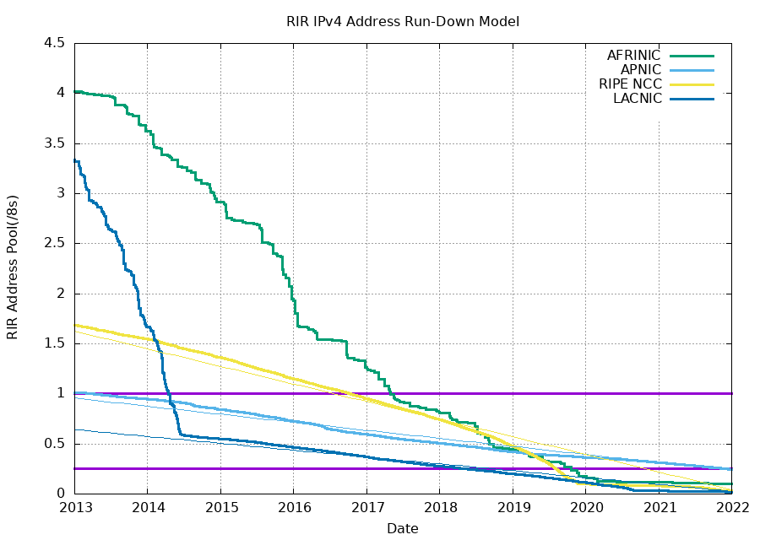
Running Out of IPv4 Addresses
IPv4 addresses are 32 bits long. 2³² ≈ 4 billion addresses. Is that enough?
2017: Every regional registry had fewer than 2²⁴ ≈ 16m addresses left.
2021: We're running out!
Notes:
https://ipv4.potaroo.net

Slide 52
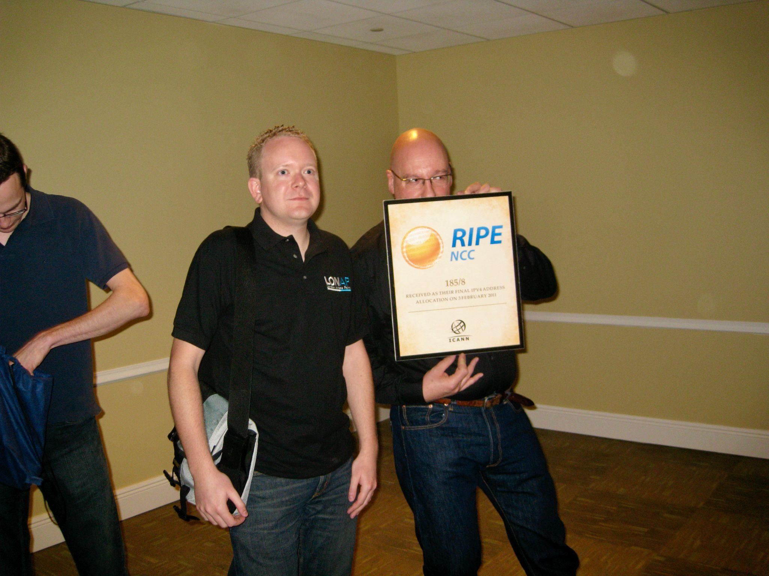
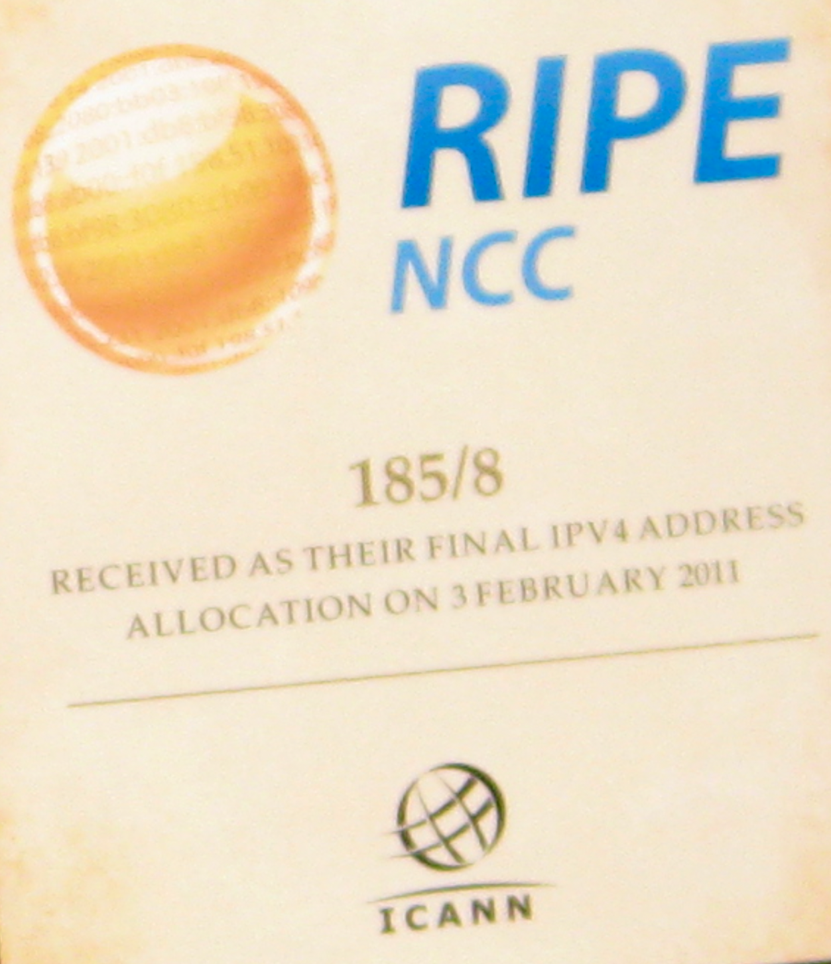
Running Out of IPv4 Addresses
A ceremony where the last range of IPv4 addresses was allocated. (February 2011)

Slide 53
Introducing IPv6
IPv6 was introduced in 1998 to deal with IPv4 address exhaustion.
Main difference: Addresses are now 128 bits, instead of 32.
Fundamentally, same addressing structure as IPv4.
Some other minor changes (won't discuss here).
Is 128 bits enough?
2¹²⁸ ≈ 3.4 × 10³⁸ possible addresses.
Assigning an address to every second of the universe's history uses 0.000000000000001% of the addresses.
We won't run out again.
IPv5 was an experimental protocol from the 1990s. It was never widely implemented.

Slide 54
IPv6 Addresses
IPv6 uses hexadecimal instead of decimal.
2001:0DB8:CAFE:BEEF:DEAD:1234:5678:9012
Colon between every 4 hex digits (16 bits).
Shorthand:
Omit leading zeros per block: 2001:0DB8:0000:0000:0000:0000:0000:0001 → 2001:DB8:0:0:0:0:0:1
Omit a long string of zeros, once per address: 2001:DB8:0:0:0:0:0:1 → 2001:DB8::1
Can still use slash notation for ranges.
2001:0DB8::/32 has 32 bits fixed, and 2⁹⁶ addresses.

Slide 55
IPv6 Addresses
IPv6 generally uses the same hierarchical addressing approach as IPv4.
Some changes:
Instead of someone (e.g. ICANN) giving you a prefix, you can pick your own prefix.
Uses a protocol called SLAAC (Stateless Address Autoconfiguration).
Pick a random prefix. If someone else is using it, pick another one.
Works in IPv6 (not IPv4) because there are so many prefixes.
In practice, prefixes usually fix at most 64 bits.
Even the smallest network has 2⁶⁴ hosts.

Slide 56
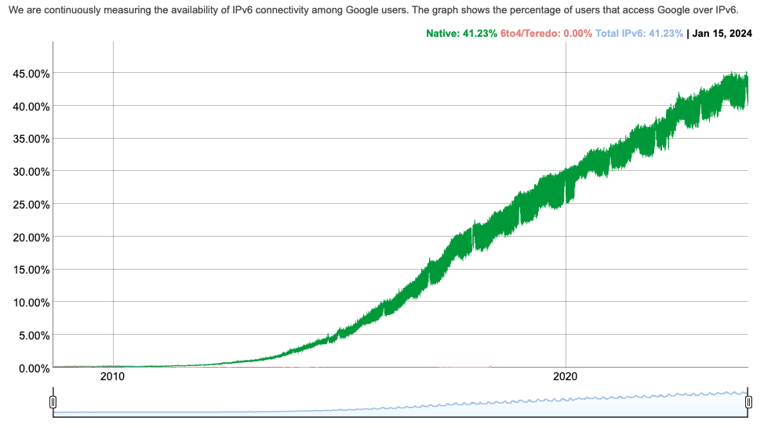
IPv6 Adoption
IPv6 introduced in the 1990s, but wide adoption started in the 2010s.
Today, ~40% of hosts have adopted IPv6.
Notes:
https://www.google.com/intl/en/ipv6/statistics.html

Slide 57
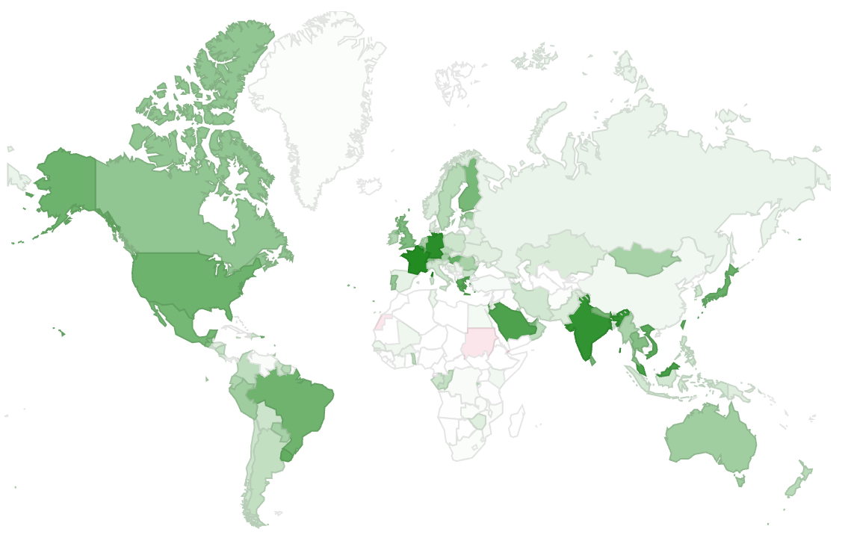
IPv6 Adoption
Adoption generally correlated with areas where there are many Internet users.

Slide 58
IPv6 Adoption – Challenges
Why is IPv6 adoption hard?
Requires software and hardware upgrades, from both hosts and routers.
IPv4 and IPv6 are not compatible with each other.
To support both, you need 2 forwarding tables.
No way to convert between IPv4 and IPv6.
If I support both IPv4 and IPv6, which should I use?
IPv6 usually faster, but other factors could affect your choice.
Main driver for IPv6 adoption: We're running out of IPv4 addresses!

Slide 59
Summary: IP Addressing
Hosts on the Internet have addresses (IPv4, IPv6, or both).
These addresses are hierarchical.
They are assigned in groups to specific organizations.
Wildcard matching means that this can help our forwarding and routing scale better.

